Slide 1
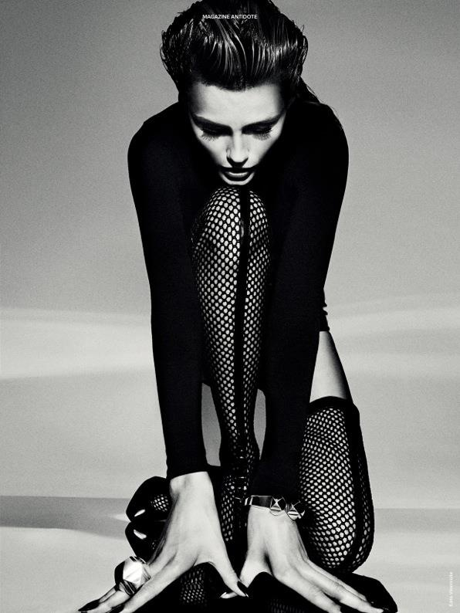
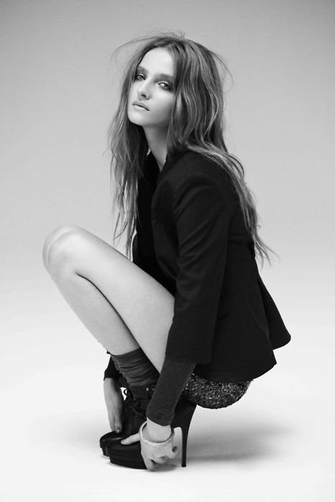
Fall Fashion Tends 2014
Ashley Ferriolo
Fashion Merchandising AM

Slide 2
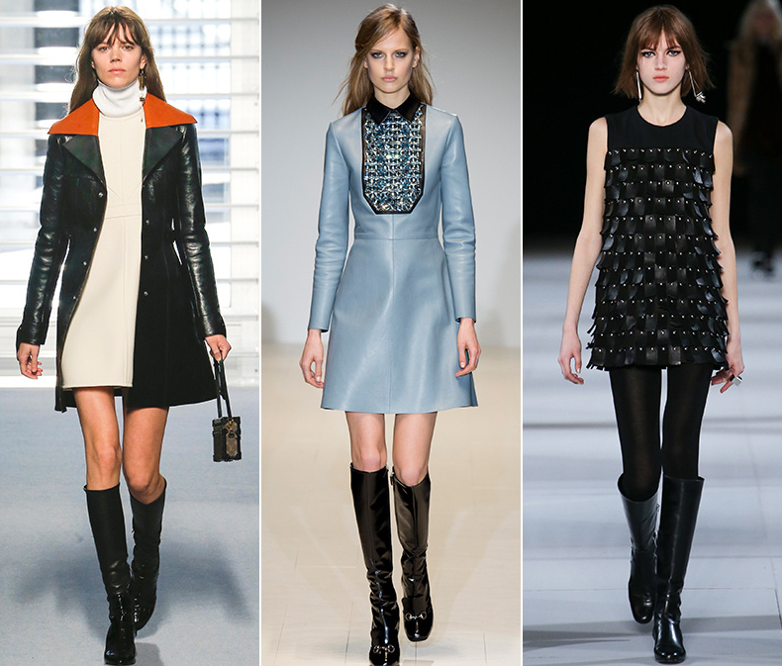
Mini-Dresses
Louis Viutton Gucci Saint Laurent

Slide 3
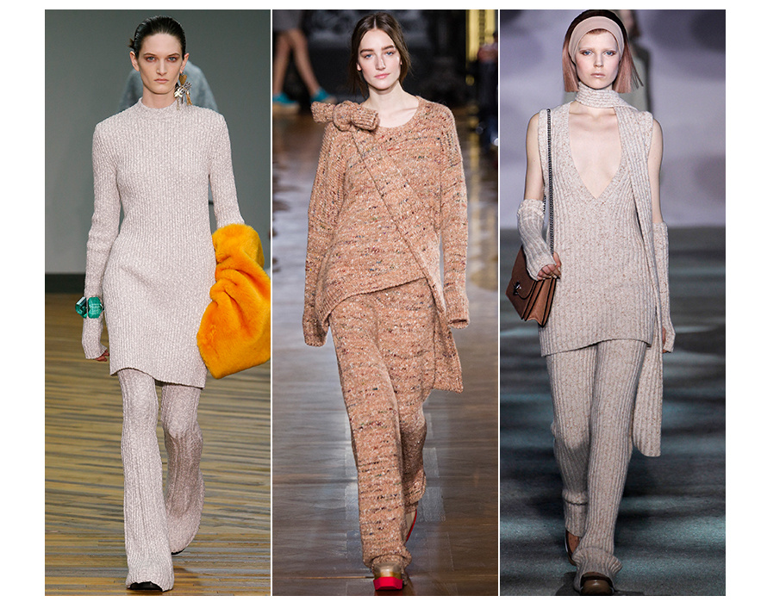
KNits
Celine Stella McCartney Marc Jacobs

Slide 4
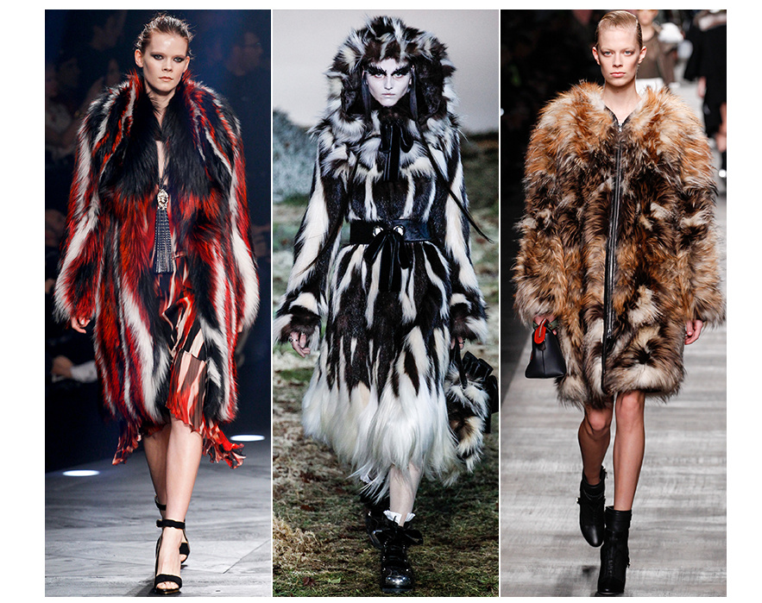
Fur
Just Cavalli Alexander McQueen Fendi

Slide 5
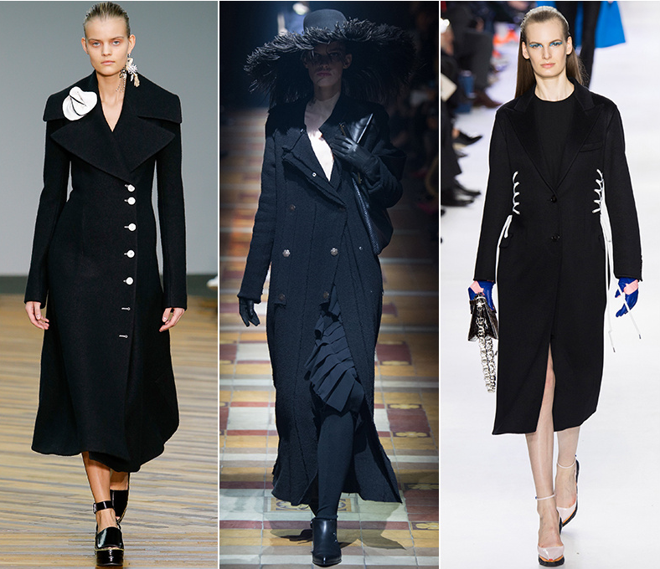
Oversized Coats
Celine Lavin Christian Dior

Slide 6
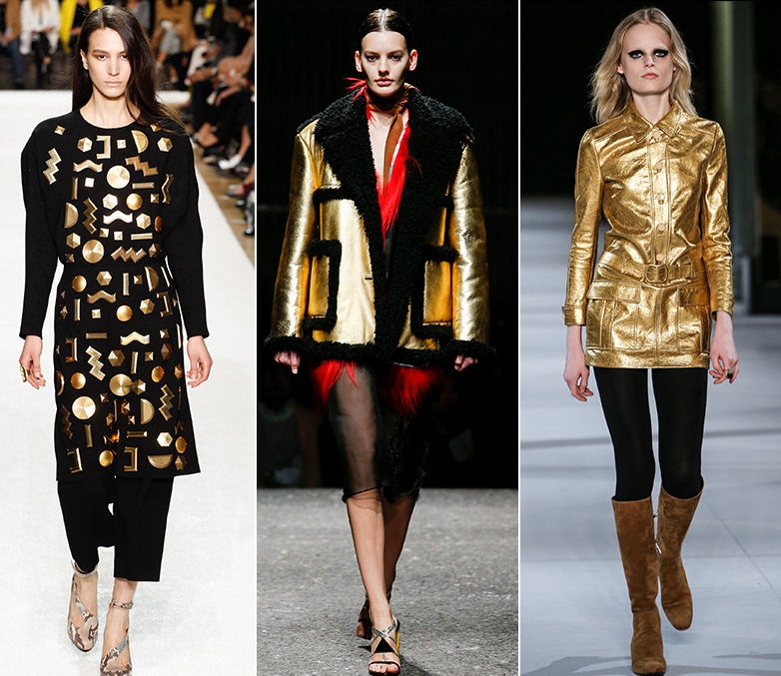
Gold
Chloe Prada Saint Laurent

Slide 7
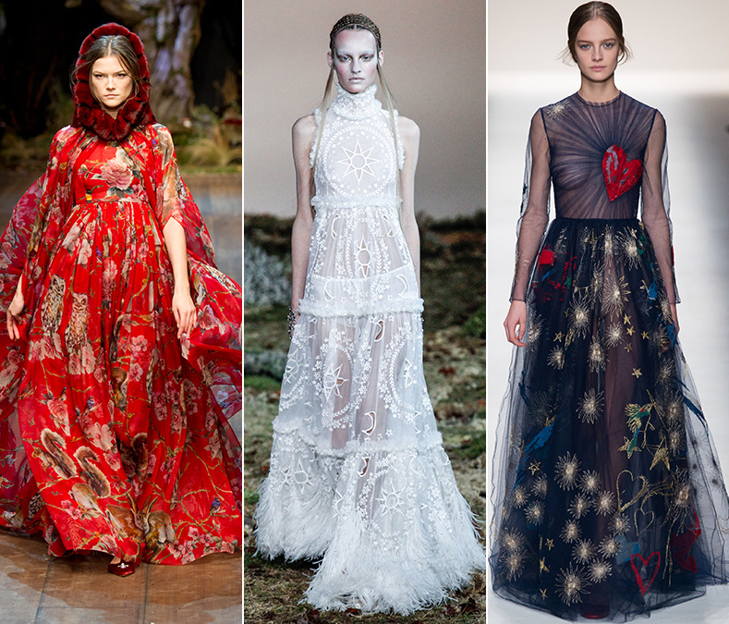
Silhouettes
Dolce & Gabanna Alexander McQueen Valentino

Slide 8
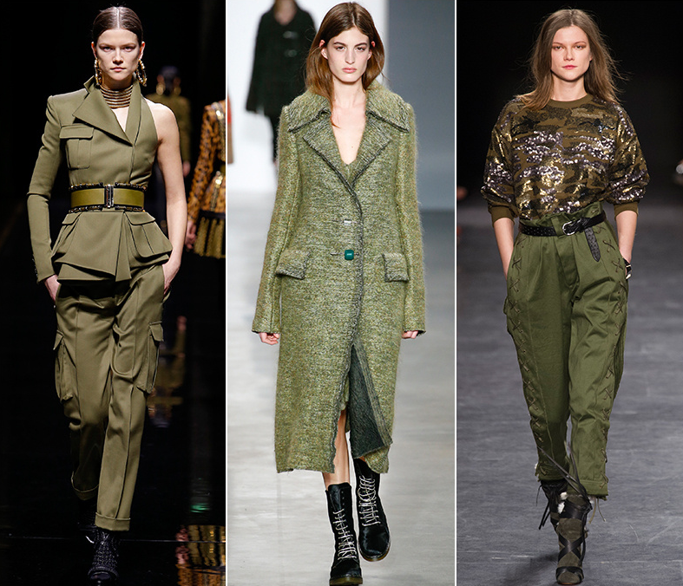
Military
Balmain Calvin Klein Isabel Marant

Slide 9
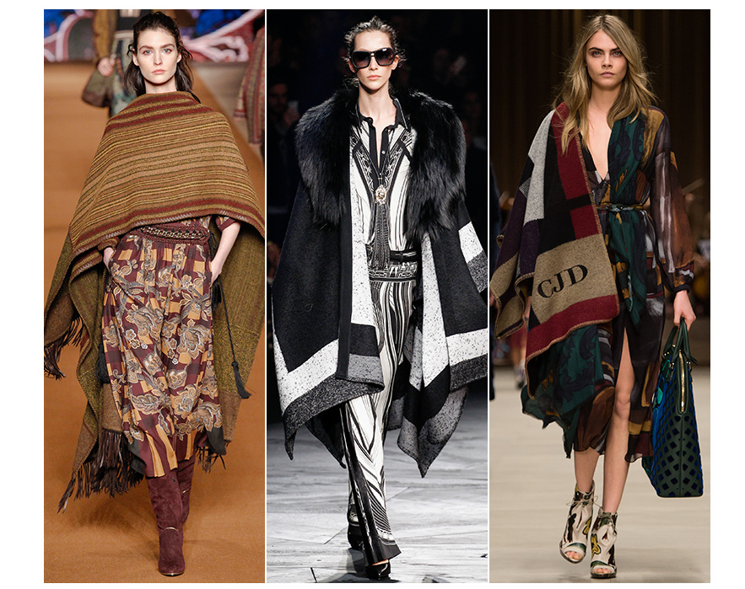
Blanket Scarf
Etro Robert Cavalli Burberry Prorsum

Slide 10
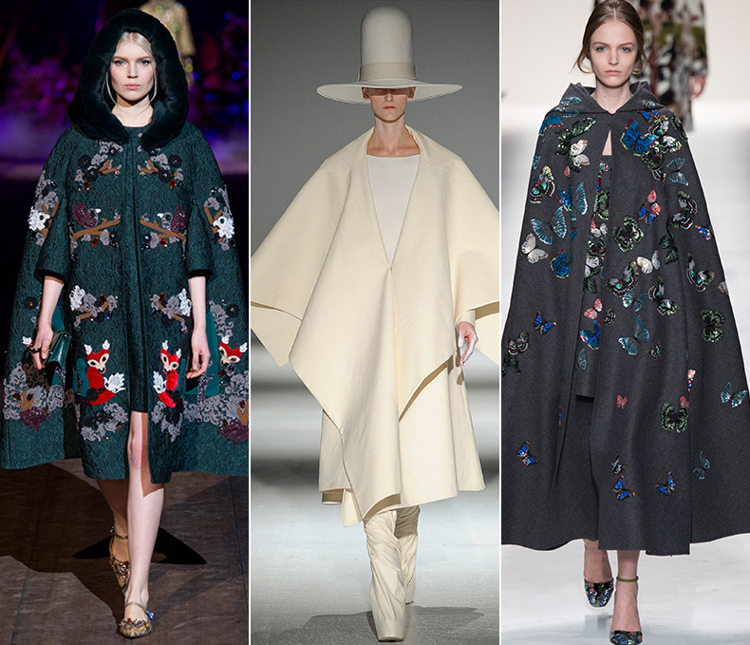
Capes
Dolce & Gabbana Gareth Pugh Valentino

Slide 11
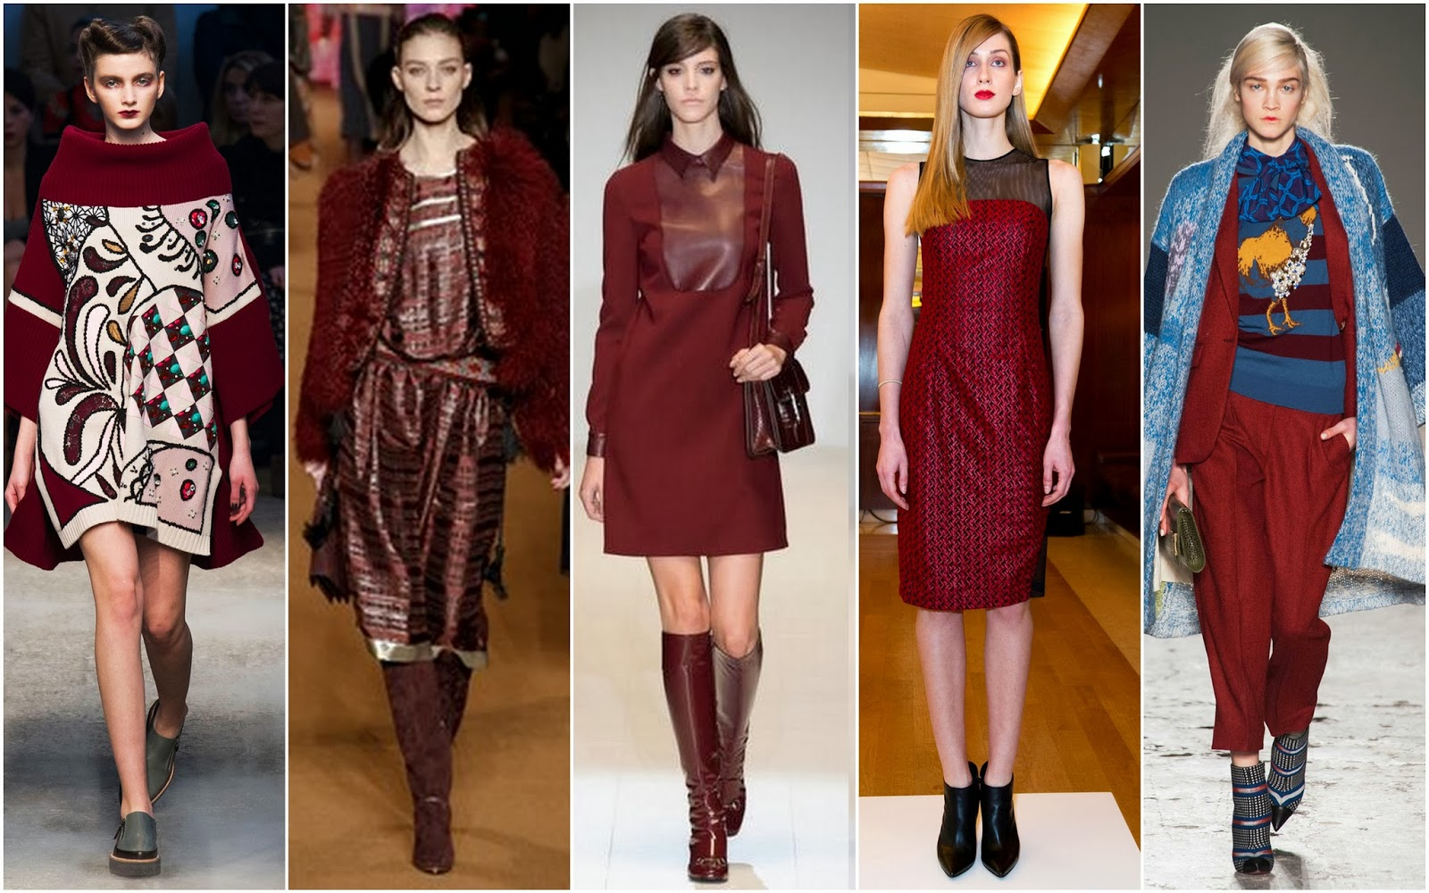
Maroon
Antonio Marras Etro Gucci Sachin+Babi Stella Jean

Slide 12
Resources www.google.com www.vogue.com www.style.com

